Slide 1


Explainable Deepfake Detection:
Leveraging Vision-Language Models for Multimedia Authentication
Guangliang Cheng
Reader (Associate Professor)
Department of Computer Science
University of Liverpool
2025.06.09

Slide 2




AI-Content Detection and Explanation
Real/Fake?
Alan Turing Institute Research Grant. “An Ethical and Robust AI Development Framework: Assessing Correctness and Detecting Fakes.” £ 260K (PI, with Prof. Xiaowei Huang)

Slide 3
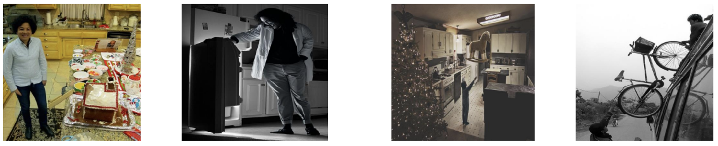
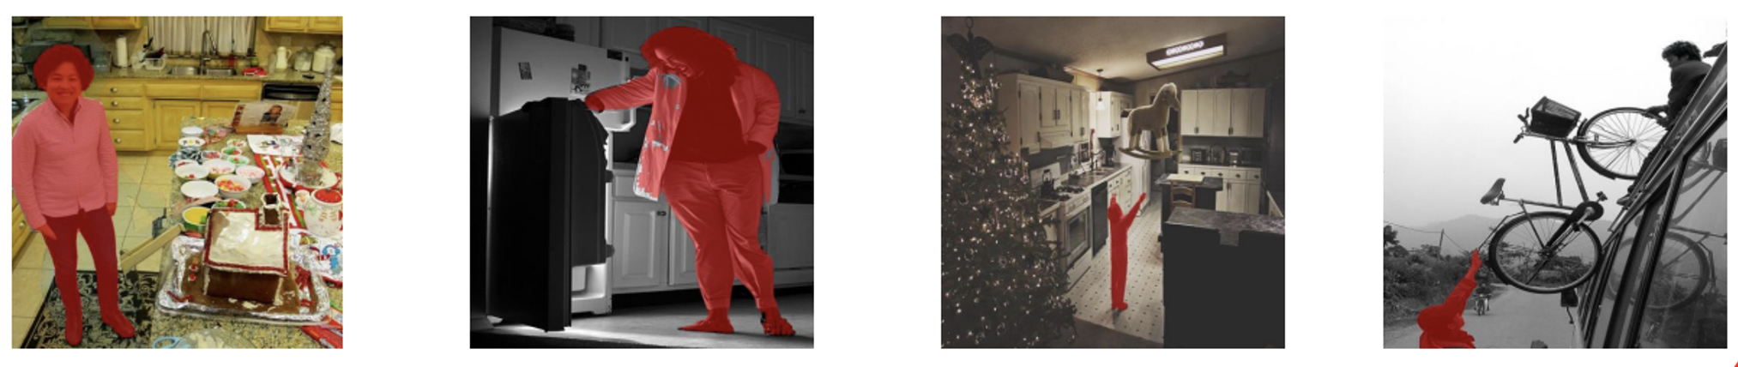
AI-Content Detection and Explanation
Real/Fake?

Slide 4
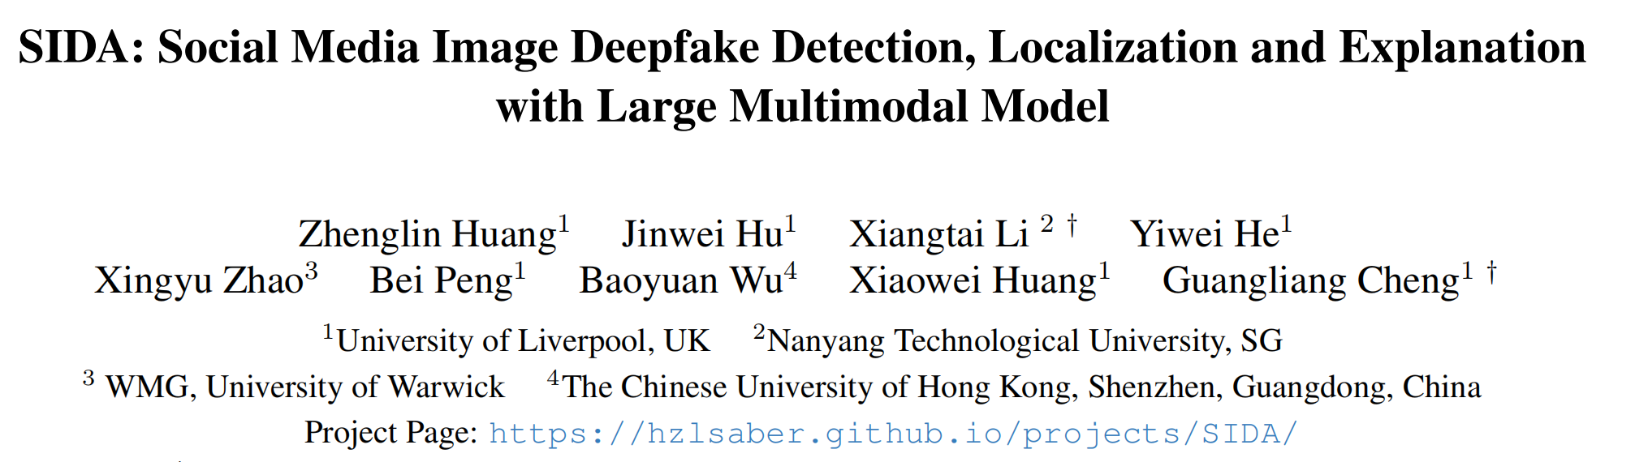
AI-Content Detection and Explanation
CVPR 2025
Huang et al. SIDA: Social Media Image Deepfake Detection, Localization and Explanation with Large Multimodal Model

Slide 5
AI-Content Detection and Explanation
Motivations
Advancements in generative technology have made non-facial deepfakes, like object and partial manipulations, increasingly challenging to detect.
Current datasets have limitations such as outdated generative methods, a lack of focus on specific manipulations, and unclear criteria for content authenticity.
Social media often mixes synthetic and tampered content, which current detection methods struggle to handle effectively.
A dataset is needed with high-quality annotations, enabling detection of both synthetic and tampered content, and providing detailed judgment criteria.

Slide 6
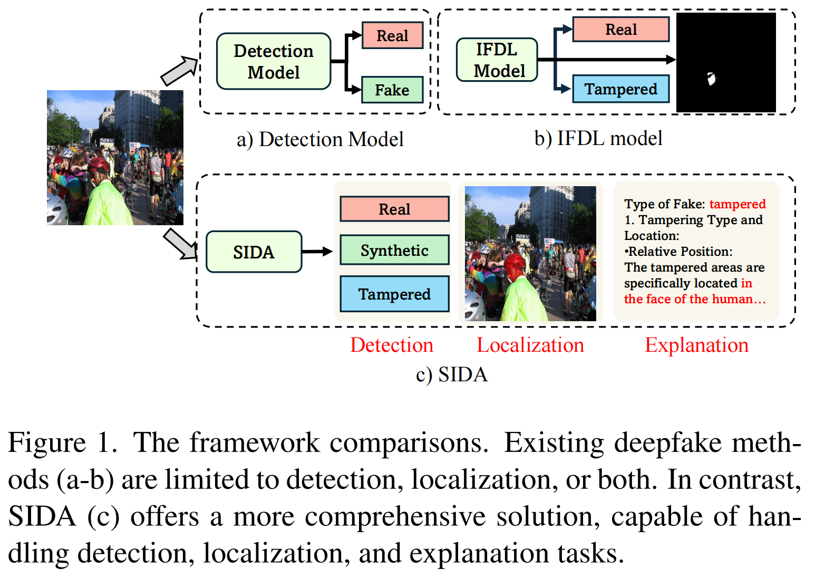
AI-Content Detection and Explanation
Task Definition

Slide 7
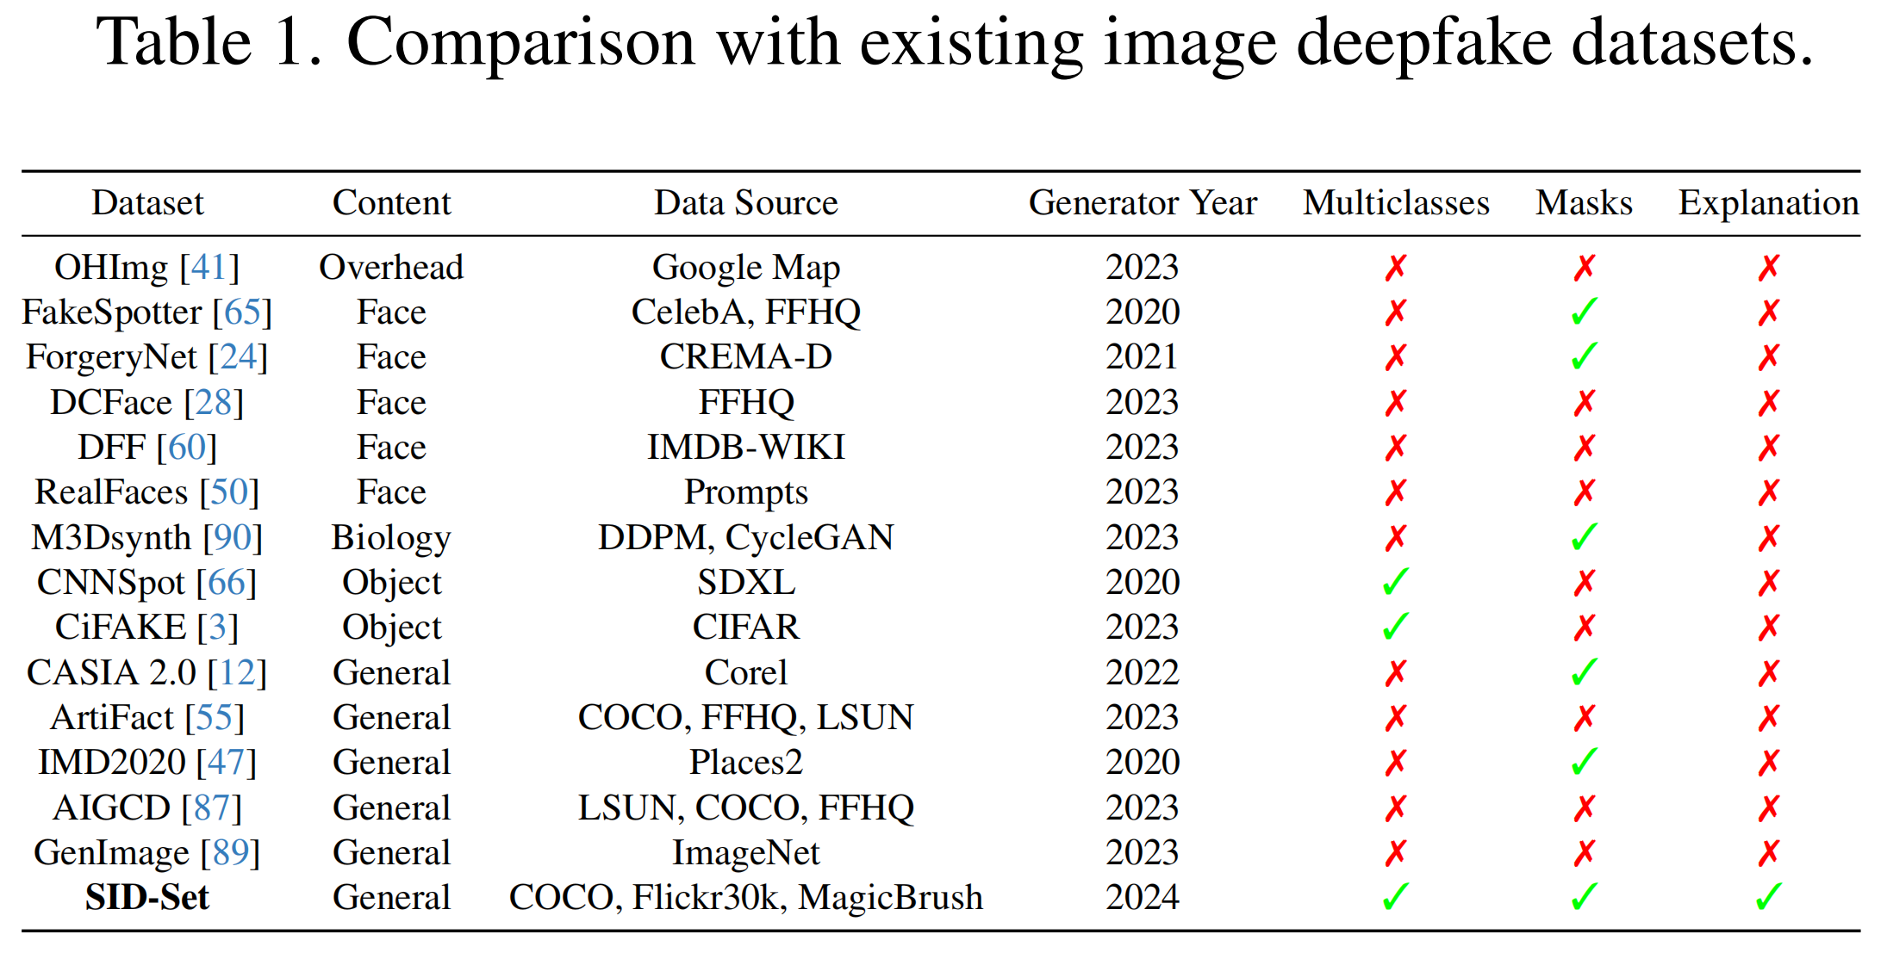
AI-Content Detection and Explanation
Dataset Comparison
The first large-scale social-media deepfake detection dataset with detection, localization and explanation

Slide 8
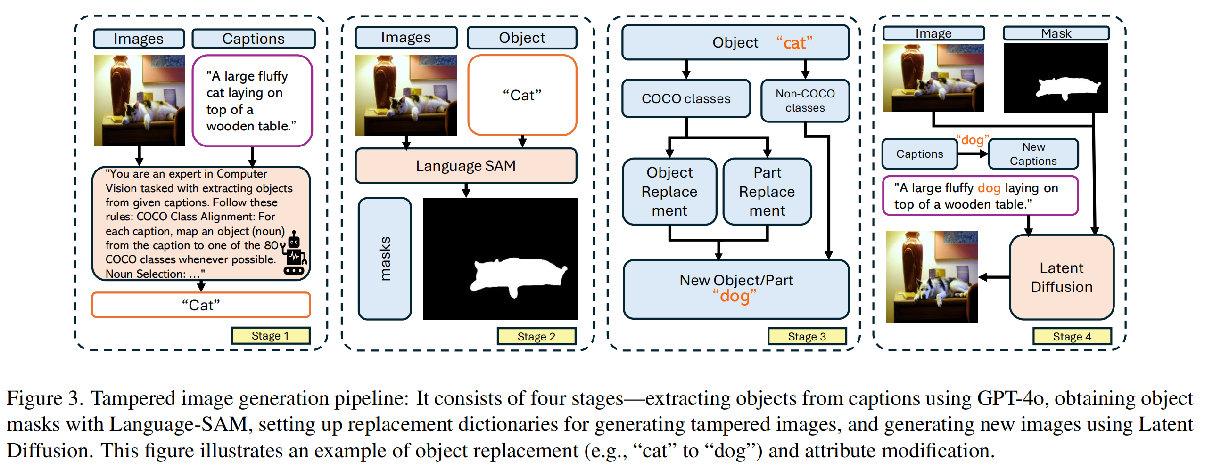
AI-Content Detection and Explanation
Dataset Construction
-- Object/Part Tampered data

Slide 9
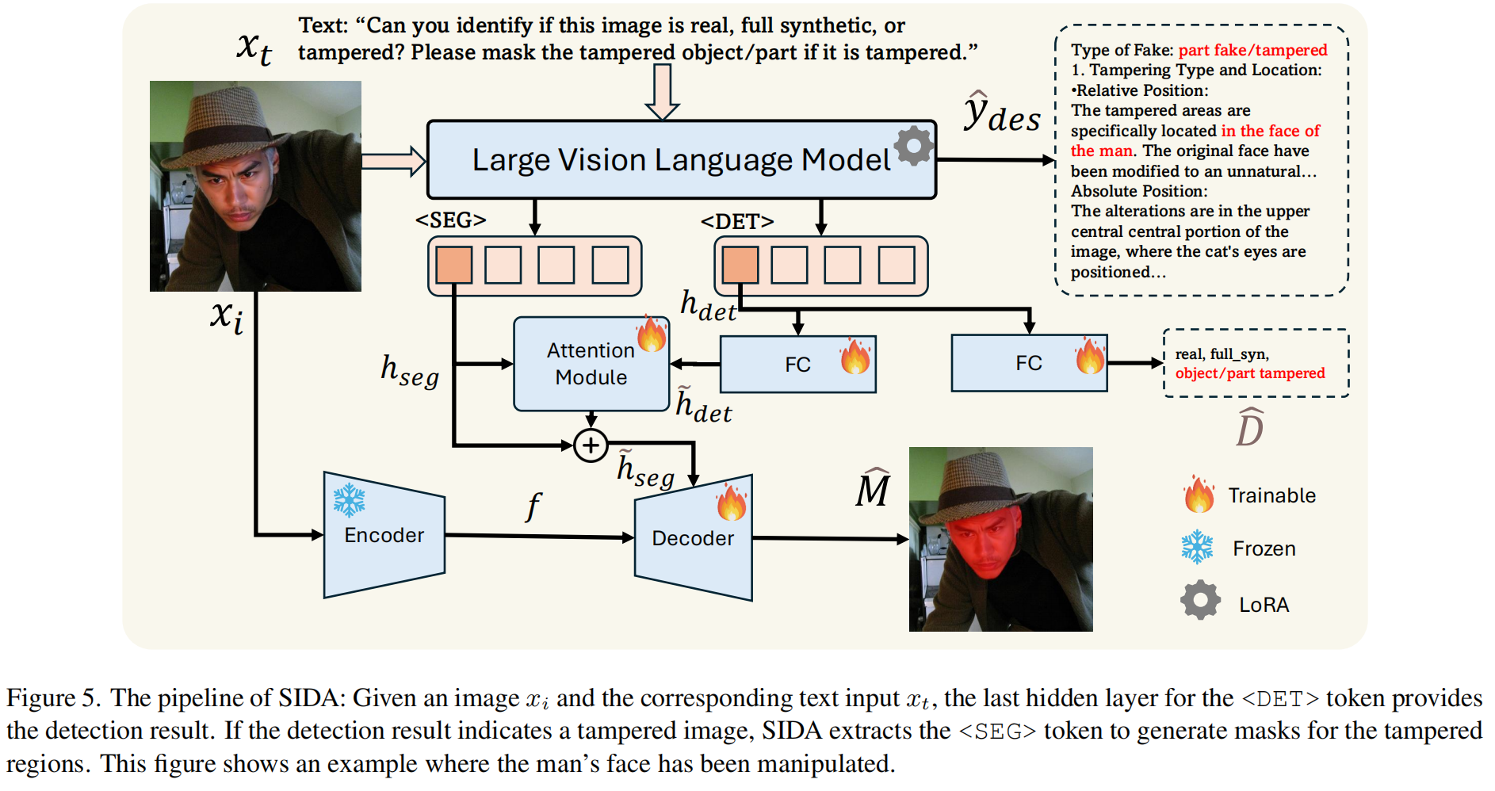
AI-Content Detection and Explanation

Slide 10
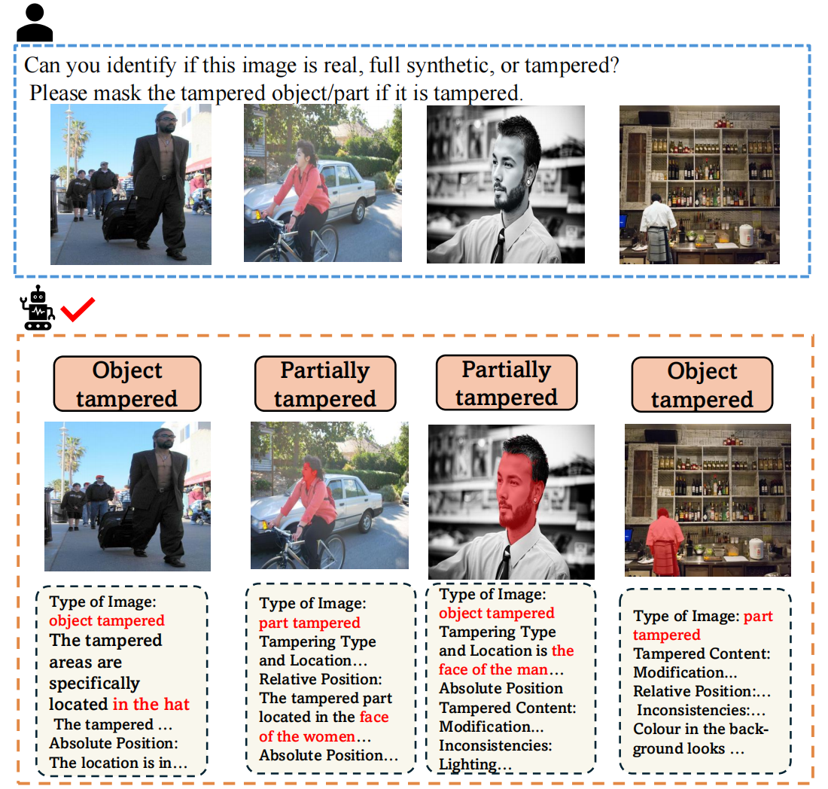
AI-Content Detection and Explanation
Examples

Slide 11
AI-Content Detection and Explanation
Pros & Cons
Pros:
1. The first largest social media image deepfake dataset with deepfake detection classification, localization, and explanation tasks.
2. One Method: SIDA, capable of detecting fake types, localizing tampered regions, and providing explanations for its decisions.
Cons:
1. The scale of the dataset is not large enough.
2. The generation methods used are relatively limited.
3. The localization capability lacks sufficient generalization.
4. The interpretable textual descriptions are relatively coarse.

Slide 12
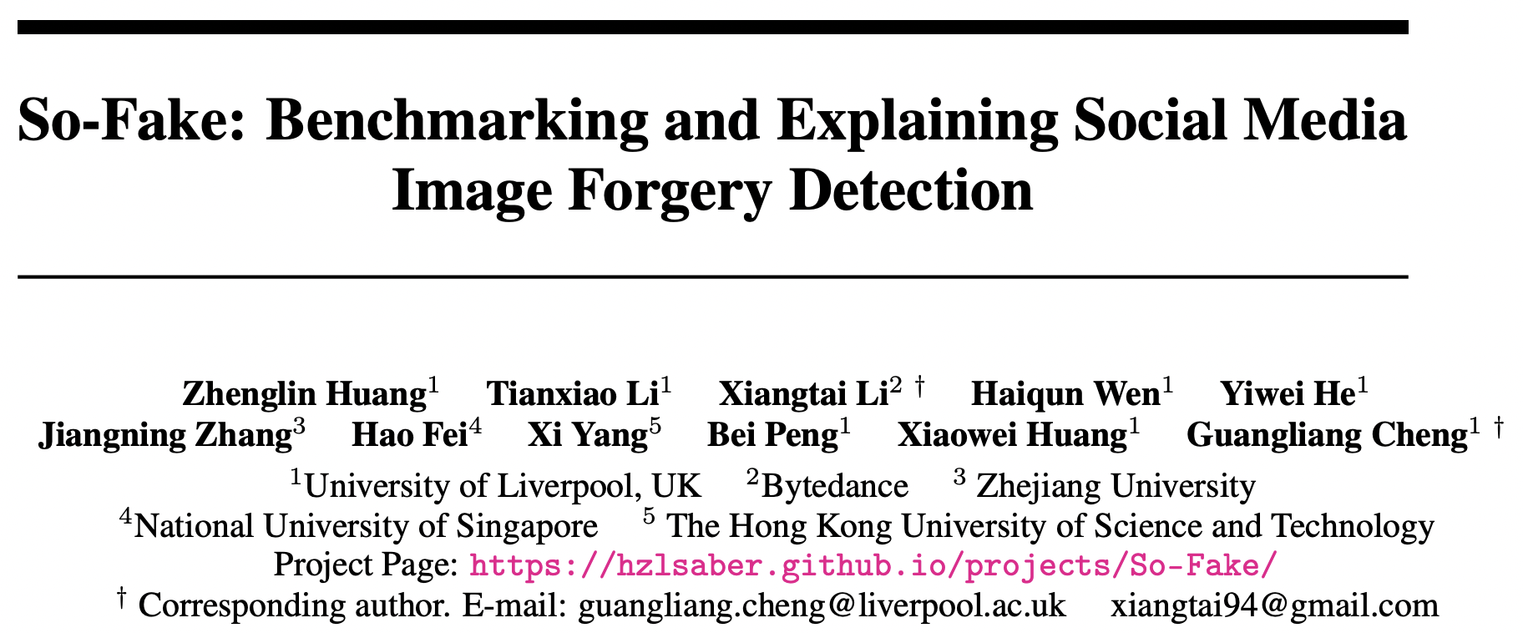
AI-Content Detection and Explanation

Slide 13
AI-Content Detection and Explanation
Motivations
Insufficient Dataset Diversity and Realism: Existing forgery datasets lack the scale, category diversity, and generative quality needed to reflect real-world social media content.
Poor Cross-Domain Generalization: Current benchmarks do not evaluate models on out-of-distribution generative techniques, limiting their robustness in practical scenarios.
Lack of Fine-grained Interpretability in Detection Models: Most detection methods offer binary outputs without explaining their decisions, making them unsuitable for high-stakes, user- facing environments.

Slide 14
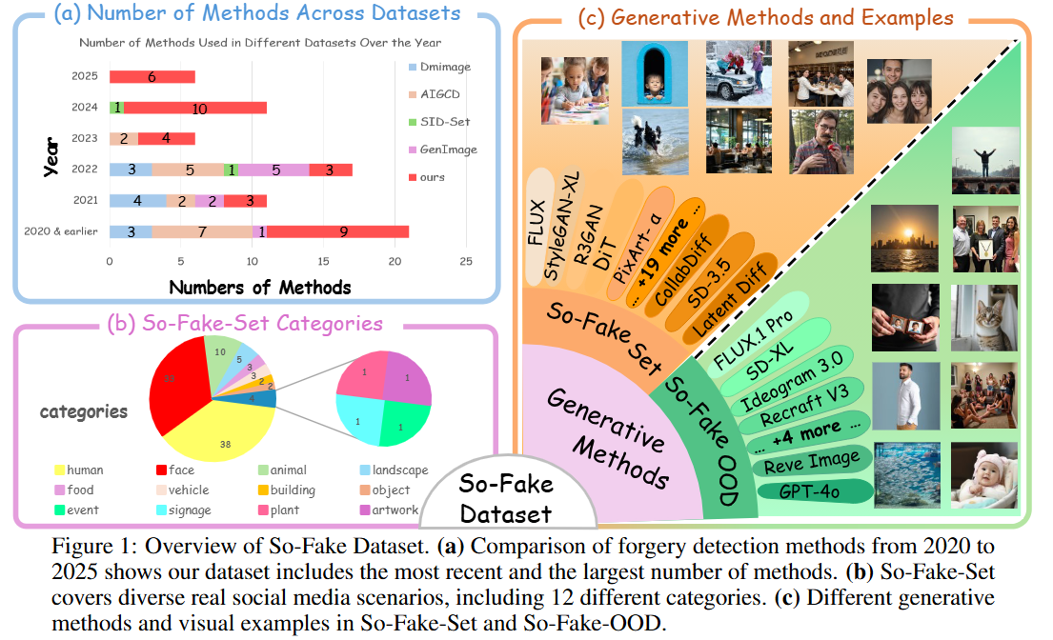
AI-Content Detection and Explanation
2M+ High-quality Images
100K In-domain Test set
100K Out-of-domain Test set
Huang et al. So-Fake: Benchmarking and Explaining Social Media Image Forgery Detection

Slide 15
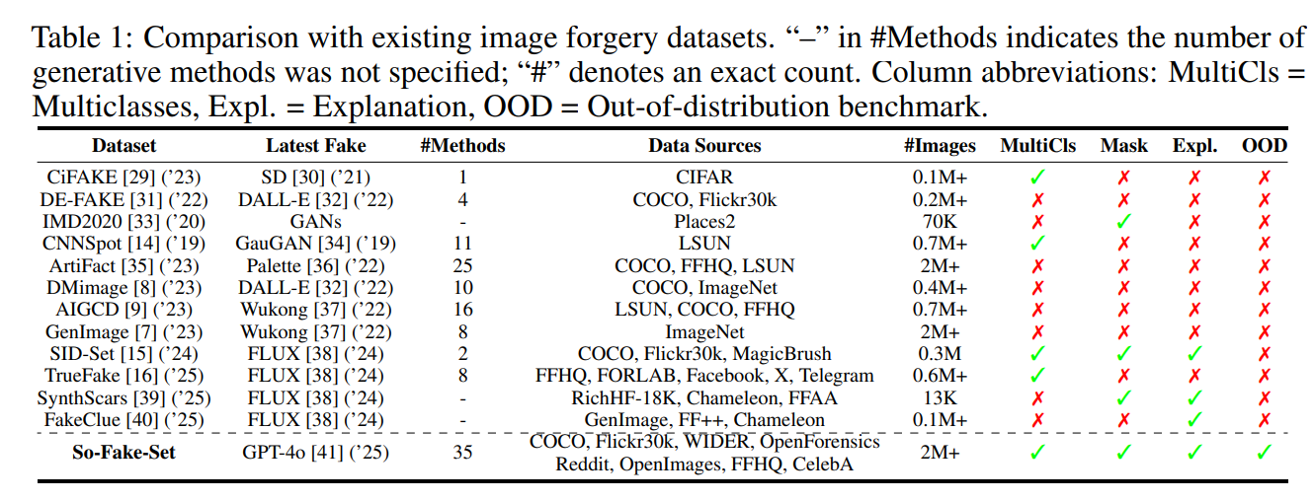
AI-Content Detection and Explanation

Slide 16
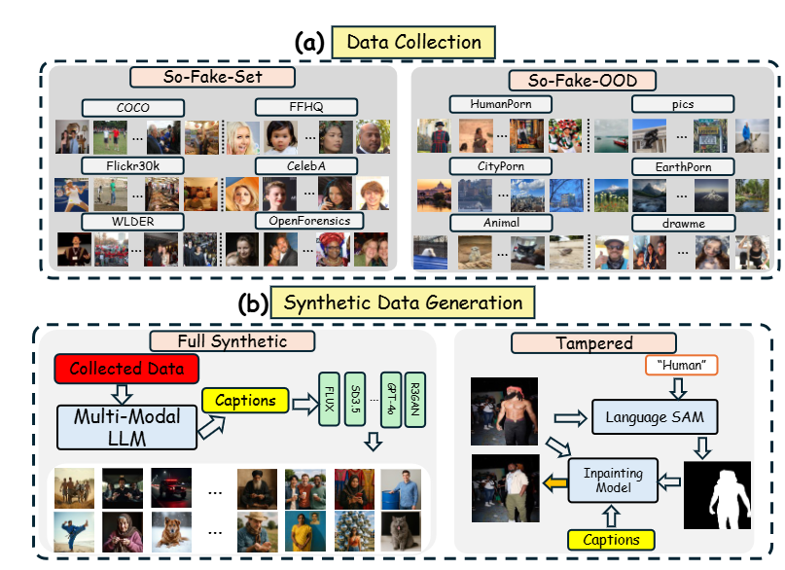
AI-Content Detection and Explanation

Slide 17
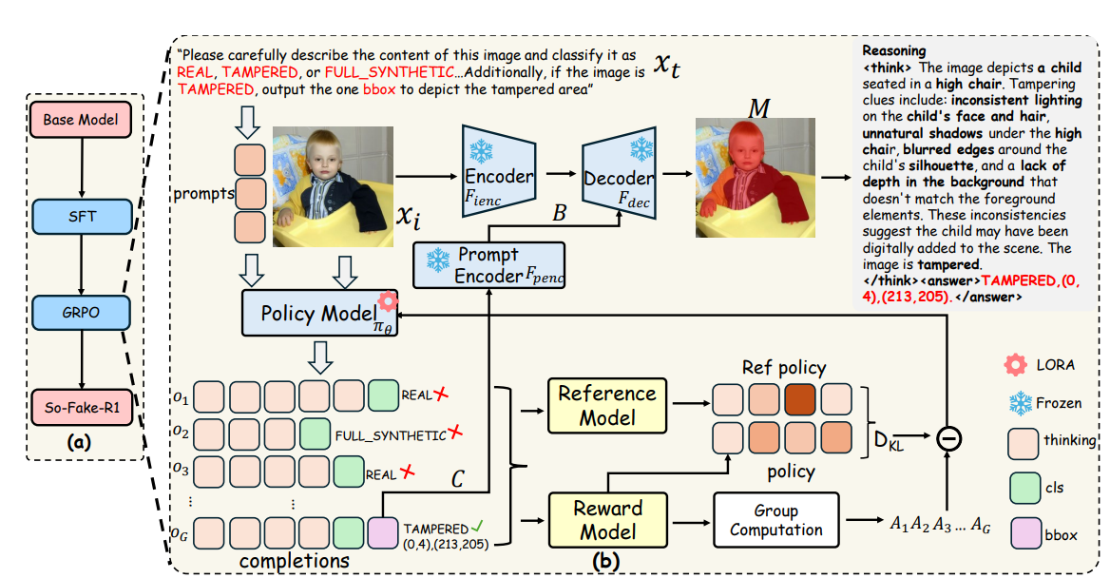
AI-Content Detection and Explanation

Slide 18
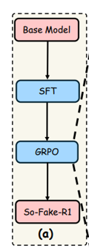
AI-Content Detection and Explanation
Five reward functions:
Thinking format reward
Classification reward
Segmentation format reward
Bounding box IOU reward
Bounding Box L1 reward
Two-stage training：
Cold start
GPRO

Slide 19
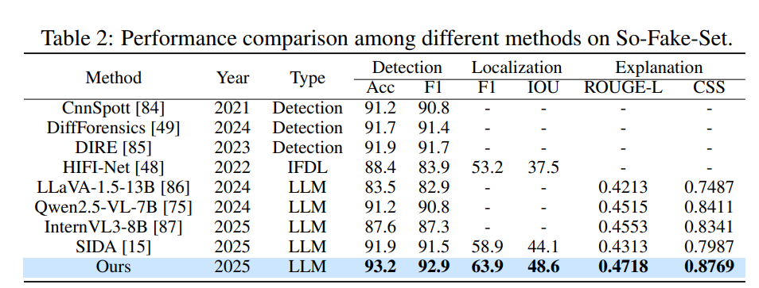
AI-Content Detection and Explanation

Slide 20
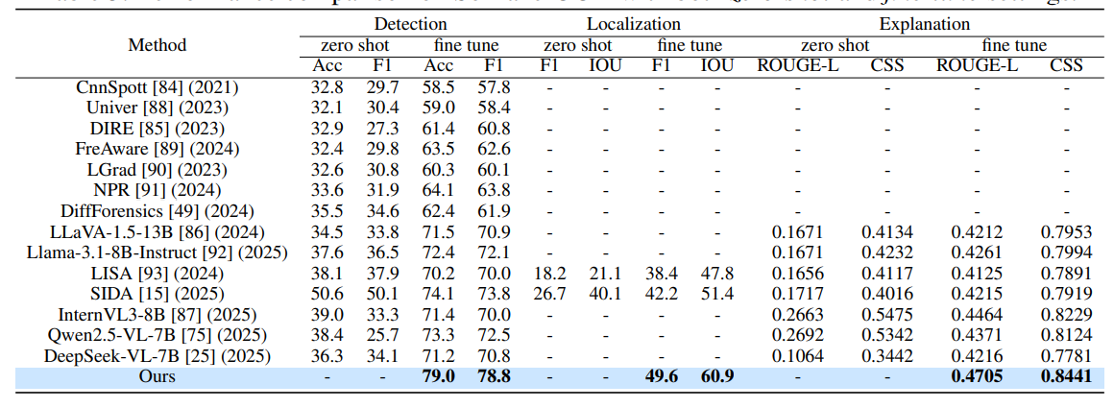
AI-Content Detection and Explanation

Slide 21
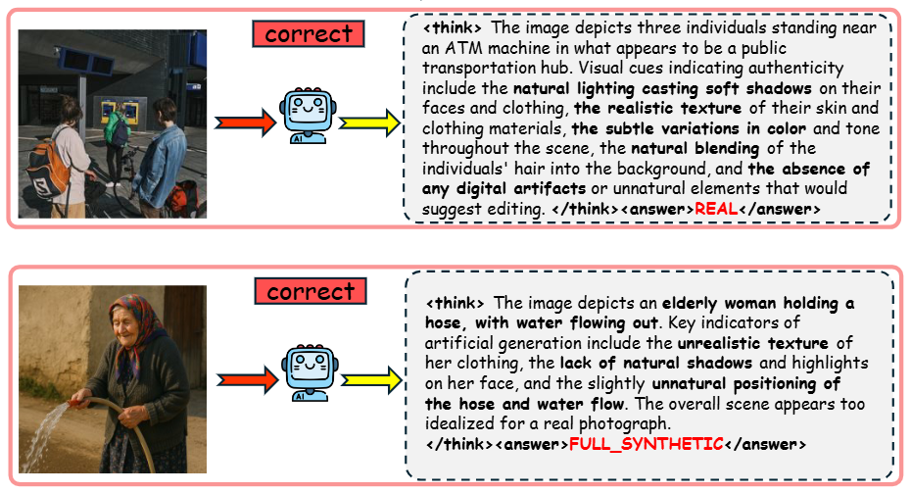
AI-Content Detection and Explanation

Slide 22
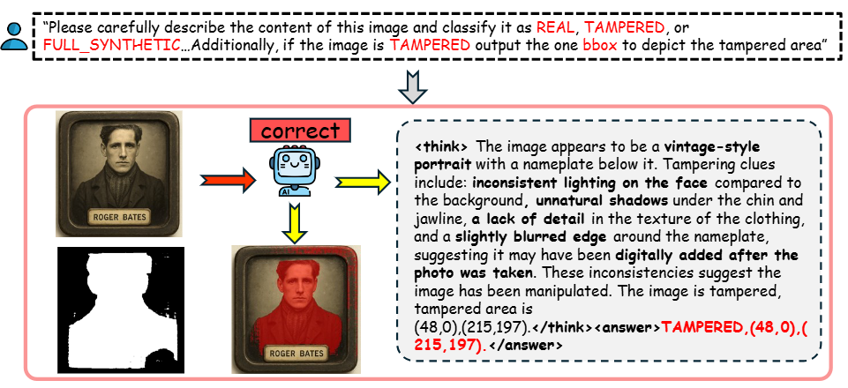
AI-Content Detection and Explanation

Slide 23
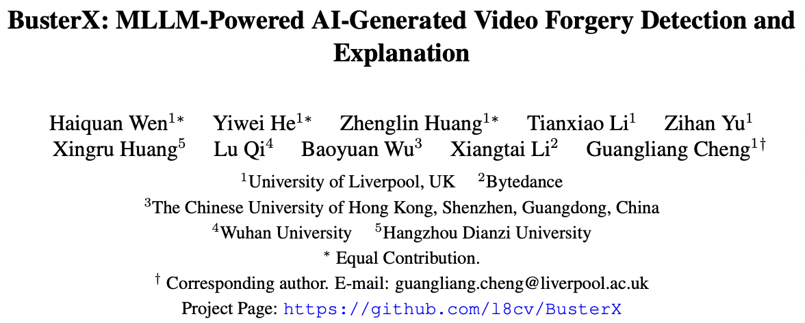
AI-Content Detection and Explanation

Slide 24
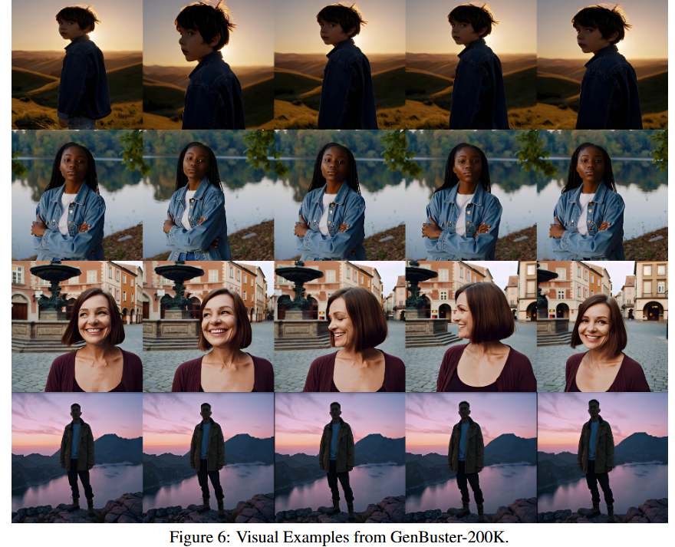
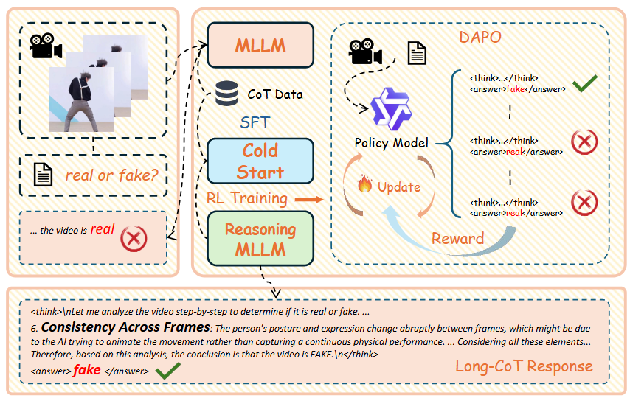
AI-Content Detection and Explanation
Wen et al. BusterX: MLLM-Powered AI-Generated Video Forgery Detection and Explanation

Slide 25
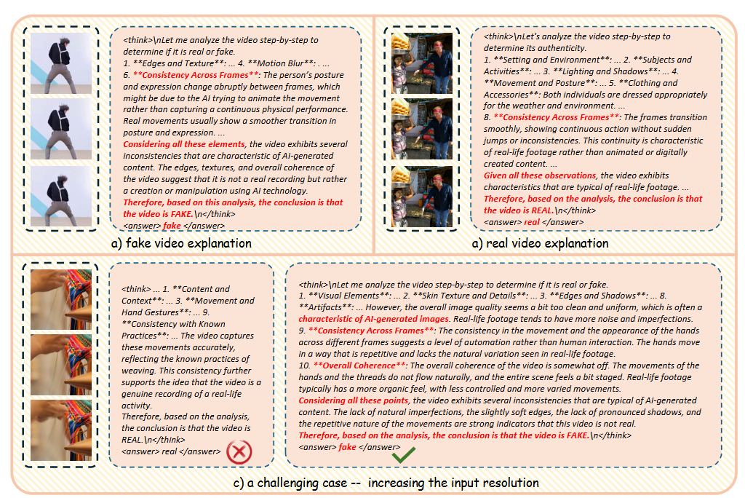
AI-Content Detection and Explanation

Slide 26
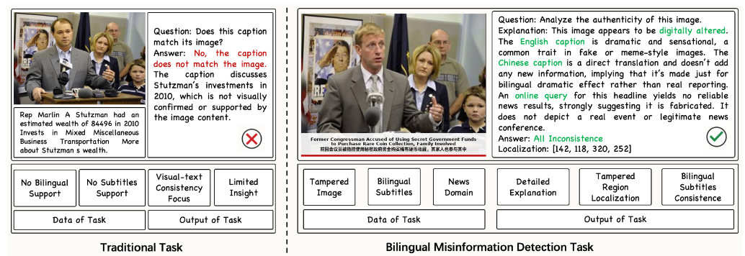
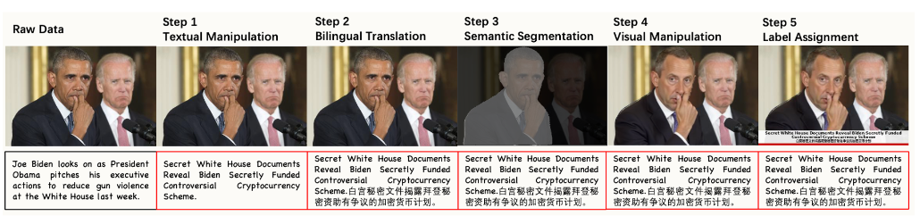
AI-Content Detection and Explanation
He et al. Towards Explainable Bilingual Multimodal Misinformation Detection and Localization

Slide 27
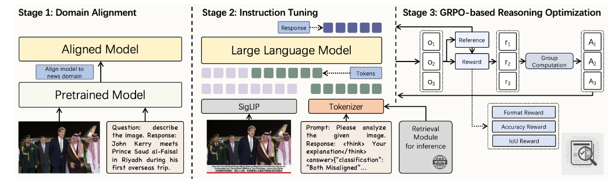
AI-Content Detection and Explanation

Slide 28
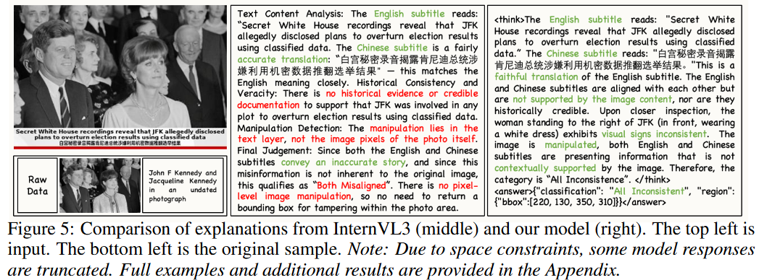
AI-Content Detection and Explanation

Slide 29
Thanks for your watching
Q & A

